Slide 1
Digital Portfolio
STUDENT NAME: SREYA G P
REGISTER NO AND NMID:
DEPARTMENT: B.Sc.COMPUTER SCIENCE WITH DATA ANALATICS
COLLEGE: KPR COLLEGE OF ARTS SCIENCE AND RESEARCH
UNIVERSITY: BARATHIYAR UNIVERSITY

Slide 2
PROJECT TITLE
online learning platforms experience

Slide 3


AGENDA
Problem Statement
Project Overview
End Users
Tools and Technologies
Portfolio design and Layout
Features and Functionality
Results and Screenshots
Conclusion
Github Link
3/21/2024 Annual Review

Slide 4

PROBLEM STATEMENT
Online learning platforms have transformed the way students and professionals acquire knowledge by offering flexibility, accessibility, and interactive resources. They allow learners to study at their own pace, attend recorded/live classes, and explore diverse subjects beyond traditional classrooms. These platforms improve self-discipline, time management, and digital skills while encouraging independent and collaborative learning. Overall, the experience enhances both academic growth and personal development by making education more engaging and future-ready.

Slide 5

PROJECT OVERVIEW
The project focuses on exploring the role of online learning platforms in enhancing educational accessibility and self-growth. It highlights how digital platforms such as Coursera, Udemy, Byju’s, and edX provide learners with flexible, interactive, and cost-effective opportunities to gain knowledge. The overview also emphasizes how online learning fosters independent study, improves digital literacy, and bridges the gap between learners and global educators. Ultimately, the project aims to showcase the impact of online platforms in reshaping education for students, professionals, and lifelong learners.

Slide 6

WHO ARE THE END USERS?
Students – who use platforms to supplement academic learning and prepare for exams.
Professionals – who upgrade skills, earn certifications, and enhance career growth.
Educators/Trainers – who deliver courses, share expertise, and connect with global learners.
Lifelong Learners – individuals seeking personal growth, hobbies, or new knowledge.
Institutions/Organizations – that adopt online platforms for training and development.

Slide 7

TOOLS AND TECHNIQUES
Learning Management Systems (LMS) – Moodle, Canvas, Blackboard
Video Conferencing Tools – Zoom, Google Meet, Microsoft Teams
Content Creation Tools – Canva, Google Slides, MS PowerPoint
Interactive Learning – Kahoot, Quizizz, Mentimeter
Collaboration Tools – Google Classroom, Slack, Trello
Assessment Tools – Online quizzes, assignments, AI-based evaluations

Slide 8
POTFOLIO DESIGN AND LAYOUT
Clean & Simple Interface – Easy navigation with a user-friendly design.
Structured Layout – Separate sections for courses, assignments, and progress tracking.
Visual Elements – Use of icons, infographics, and illustrations for better engagement.
Responsive Design – Optimized for laptops, tablets, and smartphones.
Color Themes – Soft academic tones (blue, green, grey) for a professional look.
Dashboard View – Personalized student profile with performance charts.
8

Slide 9
FEATURES AND FUNCTIONALITY
Course Access – Wide range of subjects available anytime, anywhere.
Interactive Learning – Quizzes, assignments, and discussion forums to engage students.
Live & Recorded Sessions – Flexibility to attend classes live or revisit recordings.
Progress Tracking – Dashboards to monitor learning achievements and performance.
Personalized Learning – AI-based recommendations for courses and materials.
Collaboration Tools – Chat, group projects, and peer-to-peer interaction.
Certification – Digital certificates provided upon course completion.

Slide 10

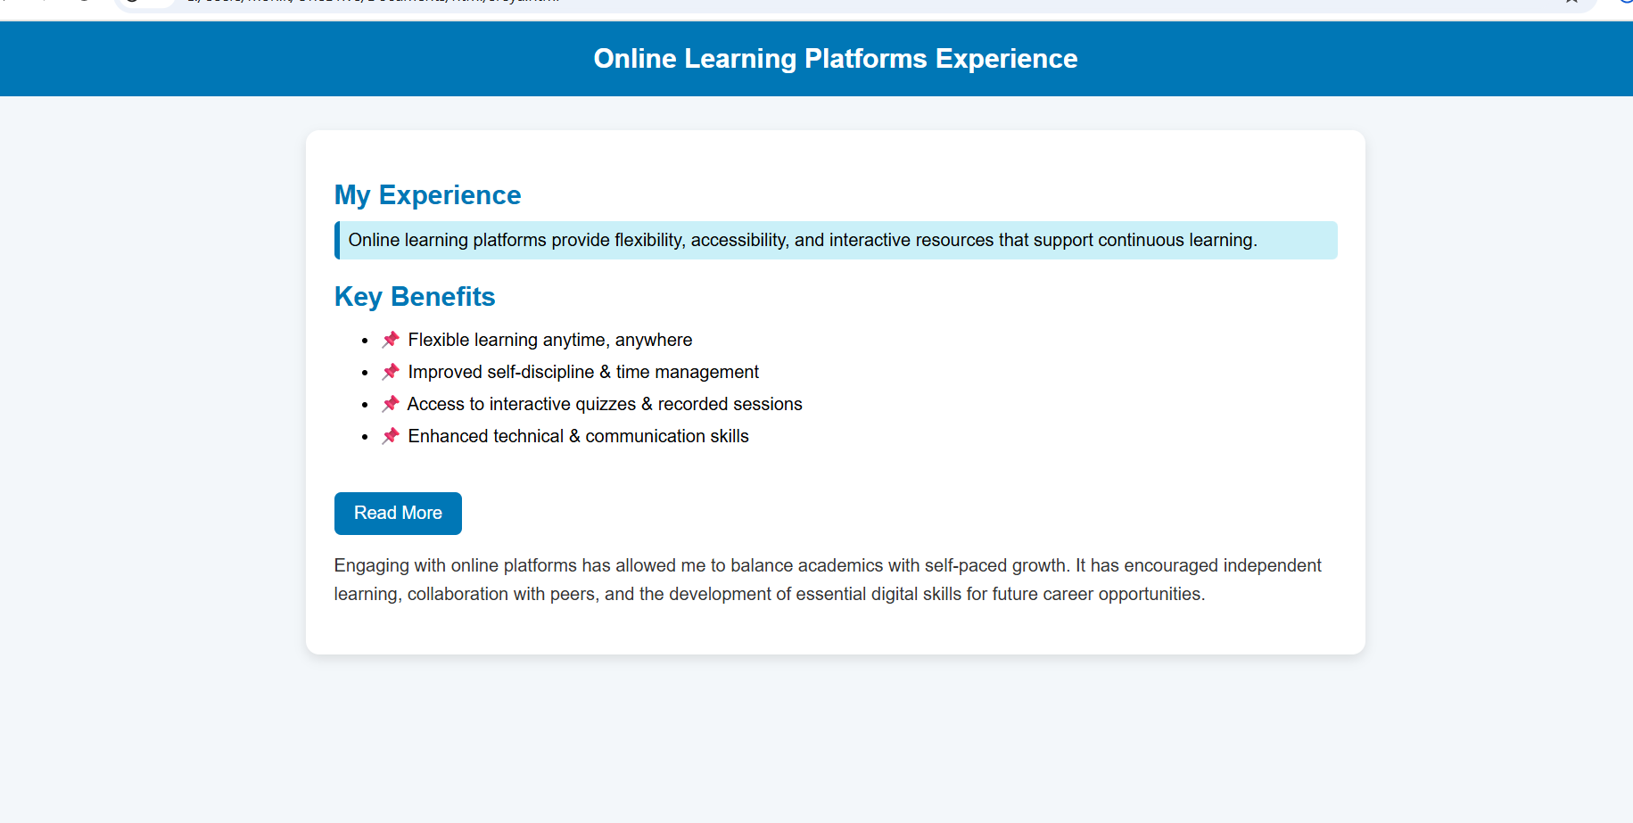
RESULTS AND SCREENSHOTS
Enhanced Learning Outcomes – Students gain deeper understanding through interactive tools.
Increased Engagement – Participation rates improved with quizzes, forums, and live sessions.
Skill Development – Learners acquire both academic and professional skills effectively.
Flexibility & Accessibility – Education made available across devices, anytime.
Performance Monitoring – Dashboards and analytics show clear progress of learners.
Screenshots (examples you can insert in slide):
Course dashboard view
Live class/lecture interface
Quiz or test result page
Certificate of completion
3/21/2024 Annual Review
10

Slide 11
CONCLUSION
Online learning platforms have transformed the way education is delivered and experienced. They provide flexibility, accessibility, and interactive tools that enhance both teaching and learning. By combining technology with education, these platforms empower students to learn at their own pace, gain valuable skills, and achieve better outcomes. Overall, online learning fosters continuous self-growth, making education more inclusive and future-ready.
11

